Slide 1
EasyCommit: A Non-blocking Two-phase Commit Protocol
Presentation for ECS 265:
Distributed Database Systems
Presented by Likang Yin
October 4, 2018

Slide 2
Roadmap
1. Background
2. Two-phase Commit (2PC) Protocol
3. Three-phase Commit (3PC) Protocol
4. EasyCommit Protocol
5. Comparison and Analysis

Slide 3
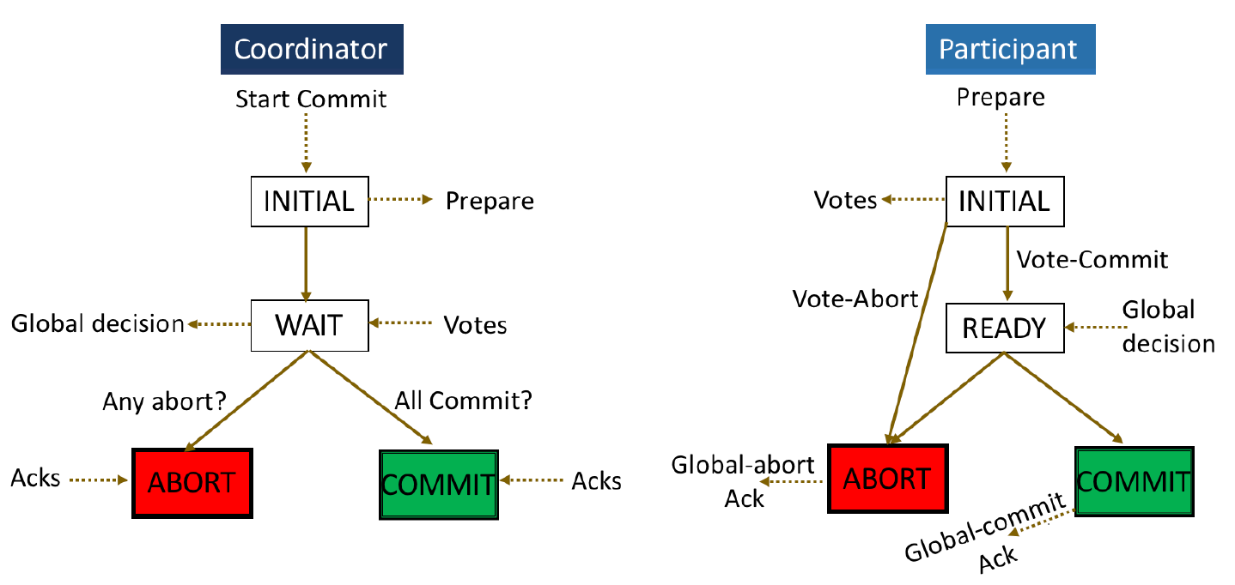
Two-phase Commit (2PC) Protocol
Source: EasyCommit: A Non-blocking Two-phase Commit Protocol. EDBT'18.

Slide 4



Blocking Problem in 2PC Protocol
Participant Y
X
Participant X
Participant Z
X
X
Coordinator C

Slide 5
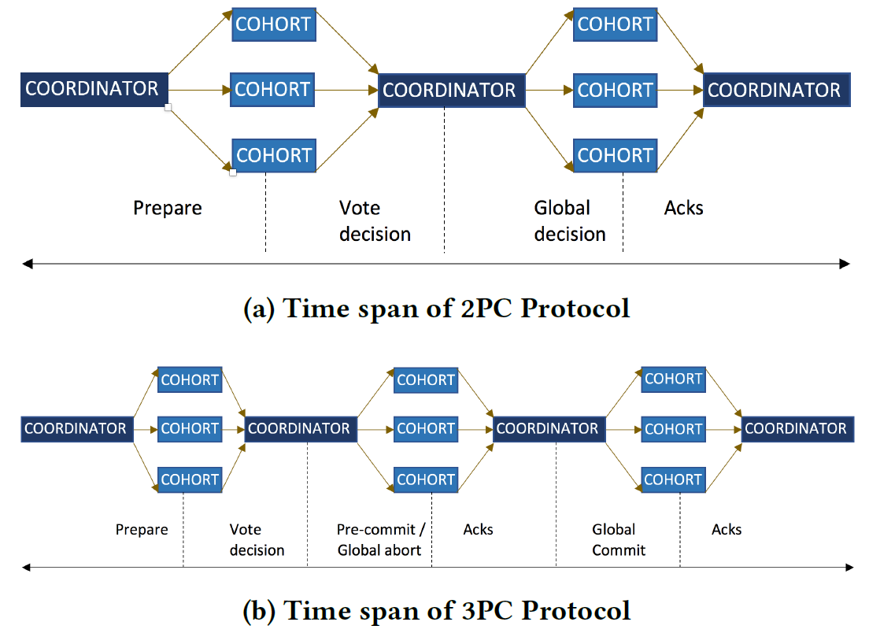
Three-phase Commit (3PC) Protocol
Source: EasyCommit: A Non-blocking Two-phase Commit Protocol. EDBT'18.

Slide 6
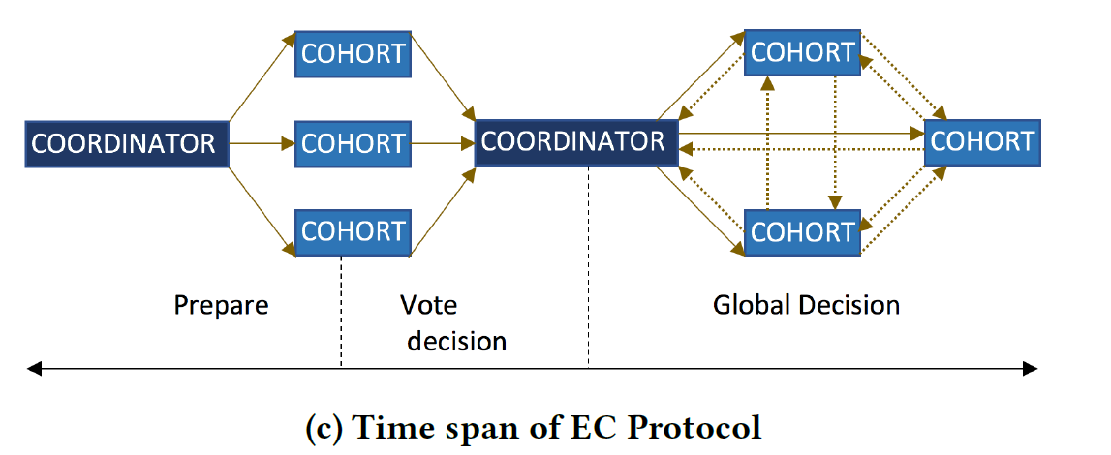
EasyCommit Protocol
Source: EasyCommit: A Non-blocking Two-phase Commit Protocol. EDBT'18.

Slide 7
Termination Protocol
Three different situations:
Coordinator Timeout in WAIT State
2. Cohort Timeout in INITIAL State
3. Cohort Timeout in READY State

Slide 8
Independent Recovery
EasyCommit Protocol can do the independent recovery when:
If a cohort fails before transmitting its vote, then on recovery, it can simply abort the transaction.
If the coordinator fails before transmitting the global decision, then it aborts the transaction on recovery.
If either coordinator or participant fail after transmitting the global decision and writing the log, then on recovery they can use this entry to reach the consistent state.

Slide 9
Conclusion
The easy commit protocol takes the advantages of both 2PC Protocol and 3PC Protocol. It is able to:
Handle commit transactions efficiently (Two phases).
Resolve the transactions safely if the coordinator fails (Non-blocking).
Execute independent recovery in three different cases. (Independent recovery).

